Slide 1
Pan Adapter on the Cheap
Bill Bathgate
KD8IGK
May 2, 2014

Slide 2
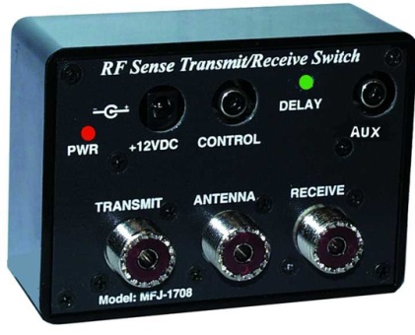
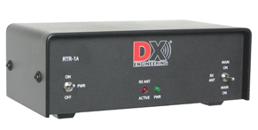
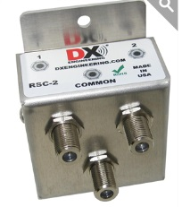
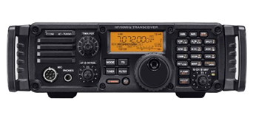
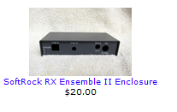
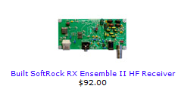

Design Concepts/Components
$79.95
$169.95
OR
MFJ-1708
RTR-1A
RSC-2
$71.95
Antenna Port
Send Port
Stereo Mic.
Soundcard
ICOM 7200
Soundcard
Via USB

Slide 3
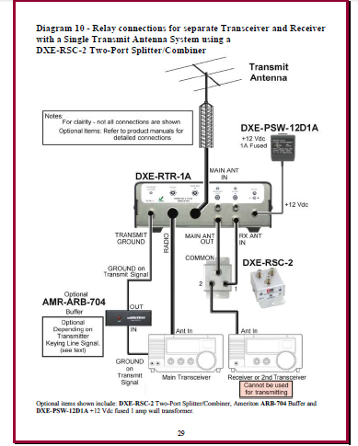
My Installation

Slide 4
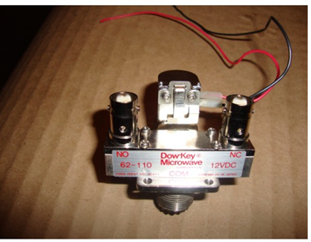
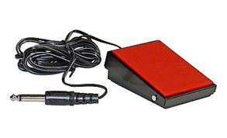
Another way
GoVerticalUSA $19.00
Dow-Key 12VDC Coaxial Antenna Relay (also diode needed)
Foot Switch
$9.95 - eBay
Stereo Mic.
Soundcard
160M-10M
ICOM 7200
Soundcard
Via USB

